Slide 1

World Wide Energy Consumption

Slide 2
Objective of the Project
To analyze relationships between energy consumption, production, GDP, population, and emissions
To understand how economic growth impacts energy usage and environmental factors
To identify trends, patterns, and key insights for better decision-making

Slide 3
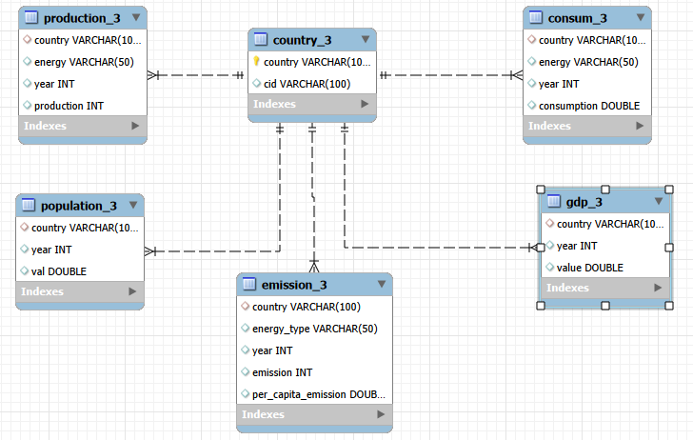

Slide 4
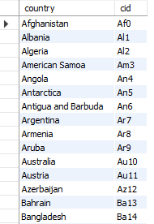
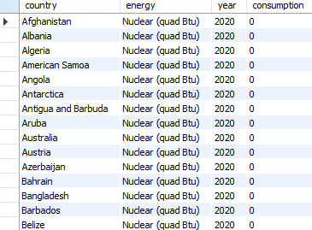
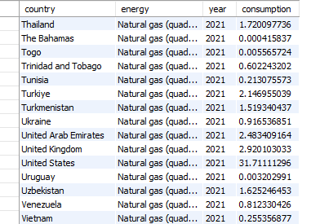
consum_3 table
Country_3 table

Slide 5
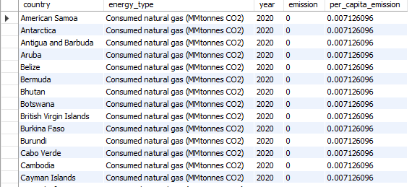
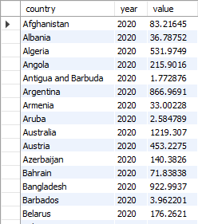
emission_3 table gdp_3 table

Slide 6
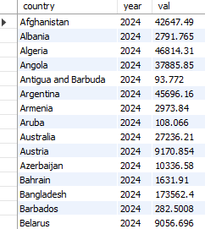
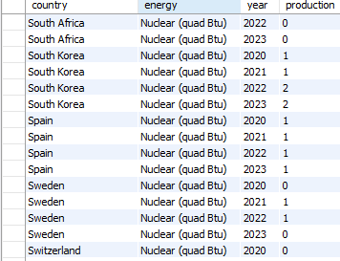
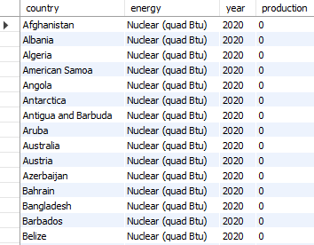
population_3 table
production_3 table

Slide 7

How have global emissions changed year over year?
select year,SUM(emission) AS total_emission from emission_3
group by year order by year;

Slide 8
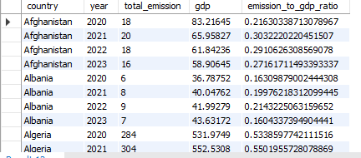
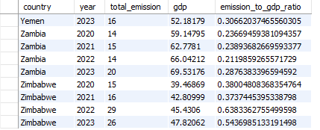
What is the emission-to-GDP ratio for each country by year?
select e.country, e.year, SUM(e.emission) as total_emission, g.value as gdp, SUM(e.emission) / g.value AS emission_to_gdp_ratiofrom emission_3 ejoin gdp_3 g ON e.country = g.country AND e.year = g.year GROUP BY e.country, e.year, g.value ORDER BY e.country, e.year;

Slide 9
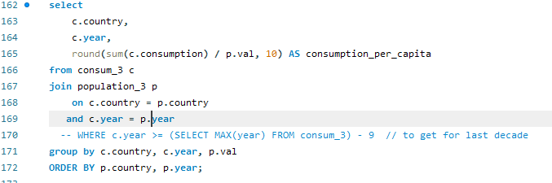
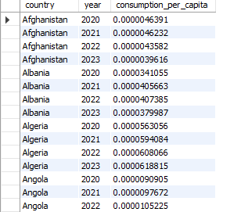
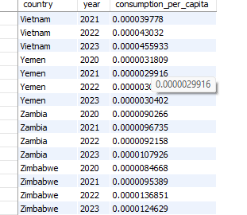
What is the energy consumption per capita for each country?

Slide 10
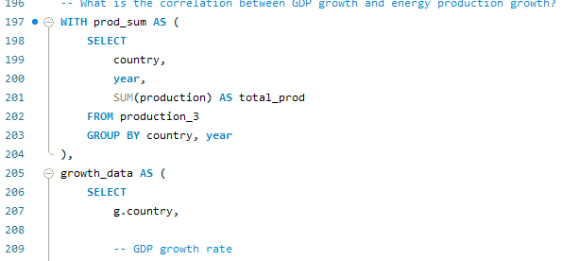
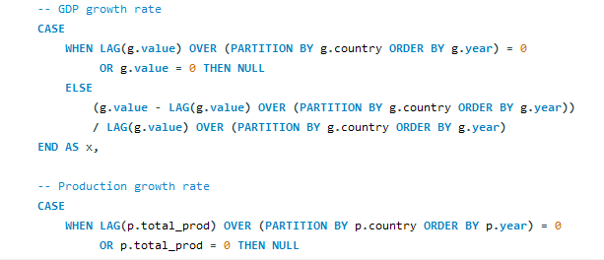
What is the correlation between GDP growth and energy production?

Slide 11
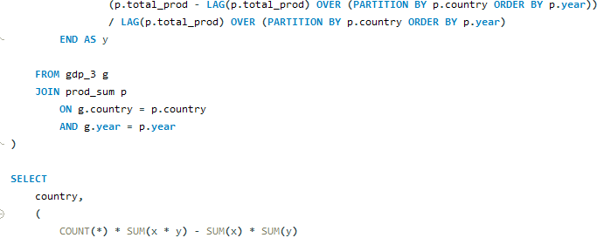
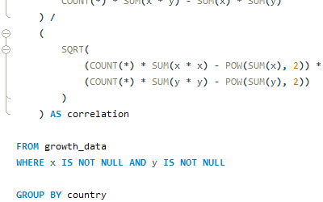
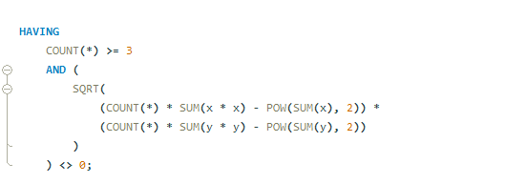


Slide 12
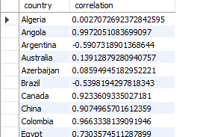
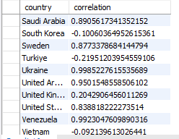

Slide 13
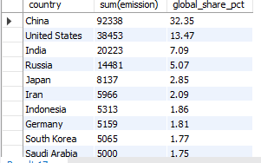
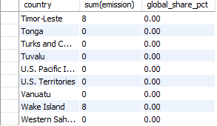
What is the global share (%) of emissions by country?
SELECT country, sum(emission), ROUND(SUM(emission) * 100.0 / (SELECT SUM(emission) FROM emission_3), 2) AS global_share_pct FROM emission_3 GROUP BY country ORDER BY global_share_pct DESC;

Slide 14
Conclusion
Global emissions are rising every year→This shows pollution is still growing
Some countries have high emissions compared to GDP→This means they are less efficient and more polluting.
Energy consumption per person is very low but varies slightly.→Small values still show important differences between countries.
Some countries show strong positive correlation, others weak or negative.→This means not all economies depend on energy production.
A few countries (China, USA, India) produce most of the emissions→Shows that global pollution is concentrated in few countries.
Global emissions are increasing, efficiency varies across countries, and a few nations dominate global pollution while economic dependence on energy differs by country.

Slide 15

THANK YOU

